Slide 1
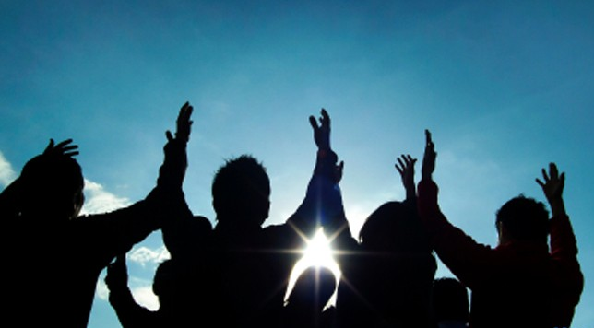
願你的國降臨
THY KINGDOM COME
CBCWLA Prayer Retreat, 9/10/2016, 8AM-12PM

Slide 2
時間 Time | 活動 Activity
8:30-9:00 | 在讚美中敬拜 Worship in Praise
9:00-10:00 | 個人祈禱 Individual Prayers 在基督裡祈禱 Pray in C.H.R.I.S.T.
10:00-11:30 | 團體祈禱 Group Prayers 藉著主禱文祈禱 Pray through the Lord’s Prayer
11:30-12:00 | 在頌榮中敬拜 Worship in Doxology 因為國度權柄榮耀全是你的直到永遠，阿們。 For thine is the kingdom and power and glory forever, amen.

Slide 3
在基督裡祈禱 Pray in C.H.R.I.S.T.
Individual Prayers: Spend 10 minutes on each category.
Church 為教會祈禱 Servants, Saints, Services. Ministers, Members, Ministries.
Home 為家庭祈禱 Family. Family. Family.
Relations 為人際關係祈禱 Relationship to enjoy, maintain, build or mend.
I 為自己祈禱 Your shalom (well-being). Your effectiveness in God’s kingdom.
Salvation 為他人的得救祈禱 Salvation for the people you know/care.
Thanksgiving 數算恩典, 獻上感恩 Count your blessings and thank Him.

Slide 4
你們禱告的時候，要說 When you pray, say…
路 Luke 11:1-2
耶穌在一個地方禱告；禱告完了，有個門徒對他說：「求主教導我們禱告，像約翰教導他的門徒。」耶穌說：「你們禱告的時候，要說…
One day Jesus was praying in a certain place. When he finished, one of his disciples said to him, “Lord, teach us to pray, just as John taught his disciples.” He said to them, “When you pray, say…
這是門徒的禱告 It’s a Disciples’ Prayer
這是團體的禱告 It’s a Community Prayer
這是典型的禱告 It’s a Pattern Prayer

Slide 5
如何禱告 How to Pray
太 Matt. 6:9-13
起首的稱呼 Opening address:
我們在天上的父 Our Father in heaven
關乎敬拜神的三件事 Three clauses about God and His Worship:
願人都尊你的名為聖 Hallowed be your name,
願你的國降臨 your kingdom come,
願你的旨意行在地上如同行在天上 your will be done on earth as it is in heaven;
關乎我們需要的三個祈求 Three petitions for our own needs:
我們日用的飲食今日賜給我們 give us today our daily bread,
免我們的債如同我們免了人的債 and forgive us our debts as we have already forgiven our debtors,
不叫我們遇見試探救我們脫離兇惡 and lead us not into temptations but deliver us from the evil one.

Slide 6
我們禱告的對象 The person we pray to
我們在天上的父 Our Father in heaven
禱告是特權的接觸：阿爸，父！ It’s a privileged access: Abba, Father!
禱告是共同的接觸：我們的父 It’s a common access: Our Father

Slide 7
按照神的優先次序祈禱 Pray with God’s priorities
神第一優先 God First:
願人都尊你的名為聖 Hallowed be your name,
願你的國降臨 your kingdom come,
願你的旨意行在地上如同行在天上 your will be done on earth as it is in heaven;
我們的需要其次 Our needs second:
我們日用的飲食今日賜給我們 give us today our daily bread,
免我們的債如同我們免了人的債 and forgive us our debts as we have already forgiven our debtors,
不叫我們遇見試探救我們脫離兇惡 and lead us not into temptations but deliver us from the evil one.

Slide 8
1. 尊榮神的名 Honor God’s name
願人都尊你的名為聖 Hallowed be your name
神的名就是「神自己」 God’s name is “God himself.”
你是否在日常生活中提到神（的名）Do you mention God (his name) in your daily living?
願我們尊榮神的名 May we as a church honor God’s name.
願他人因我們而尊榮神的名 May others come to honor God’s name through us.

Slide 9
2. 彰顯神的國 God’s Kingdom manifested
願你的國降臨 Your Kingdom Come
神的國就是「神的王權彰顯之處」 God’s kingdom is “where God’s kingship is manifested.”
願神的能力與王權在我和我們的教會中彰顯 May God’s power and his kingly rule be manifested in me and in our church.
願神的能力與王權在世人之中彰顯 May God’s power and his kingly rule be manifested in the world.

Slide 10
3. 遵行神的旨意 Obey God’s will
願你的旨意行在地上如同行在天上 Your will be done on earth as it is in heaven
願我們遵行神的旨意 May we be obedient to God’s will
願世人也遵行神的旨意 May God’s will be done even by people who don’t know him yet.

Slide 11
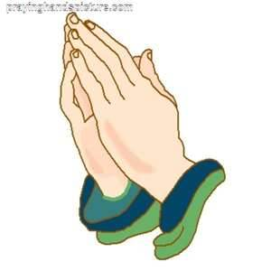
4. 賜給我們日用的飲食 Give us our daily bread
我們日用的飲食今日賜給我們 Give us today our daily bread
日用的飲食就是「日常的需要」Daily bread is “daily needs”
我們仰望神供應日常所需 We rely on God to provide for our daily needs.

Slide 12
5. 免了我們的債 Forgive us our debts
免我們的債如同我們免了人的債 Forgive us our debts as we have already forgiven our debtors
每個人都欠神的債也欠人的債 Each person is in debt to God and other people.
願神赦免我們的債，如同我們赦免了他人的債 May God forgive our debts in accordance with the forgiveness we extend to others.
當人人都赦免他人的債，我們自己的虧欠也得到赦免 When we all forgive the debts of other people our own debts are also forgiven by other people.

Slide 13
6. 救我們脫離那惡者 Deliver us from the Evil One
不叫我們遇見試探救我們脫離兇惡 Lead us not into temptations but deliver us from the evil one
確認一：神與我們同在，他在帶領我們 Acknowledgement 1: God is present in our lives. He is leading us.
確認二：我們的軟弱，需要神的幫助 Acknowledgement 2: We’re weak. We need God’s help.
確認三：我們在主裡得勝，神能夠，神也願意，救我們脫離那惡者 Acknowledgement 3: We are victorious in the Lord. God is able and willing. He can and will deliver us from the evil one.

Slide 14
我們教會的頌榮 Our Church’s Doxology
因為國度、權柄、榮耀全是你的，直到永遠。阿們。 For yours is the kingdom, and the power, and the glory, forever. Amen.
國度：我們的教會屬於神的國度。在我們教會中神的名得到尊榮，神的旨意被遵從 。 Kingdom: Our church belongs to God’s kingdom. In our church God’s name is honored and his will is obeyed.

Slide 15
我們教會的頌榮 Our Church’s Doxology
權柄：我們的教會彰顯神的權柄。我們的教會強而有力，因為我們的神強而有力。 Power: Our church manifests God’s power. Our church is strong and powerful because our God is strong and powerful.
榮耀：我們的教會顯出神的榮耀。我們是一間榮耀的教會，因為在我們教會惟有神得榮耀。 Glory: Our church reveals God’s glory. Our church is a glorious church because in our church God alone receives the glory.

